Slide 1
Future Exotic Auto
Yang Li
Yutong Gao

Slide 2
Overview
Introduction
CSS Properties
Workflow
Demo
Contribution
Notes:
Login features - Database for users

Slide 3
Introduction
We are plan to design a professional full-service auto dealership website. Our website services include:
Buy and Sell
Maintenance
Repair
Value Appraisal.
Notes:
Login features - Database for users

Slide 4
CSS properties
text-style
font-family
font weight
font size
color
Image
width: px / %
height: px / %
Background
backgound-size
background-color
backgournd-image
Position:
padding
margin
top/bottom/left/right
position: absolute
float: right;
display:inline-block
text-align
link
Cursor: pointer
transition: all 0.3s ease 0s;
hover
Unordered list
list-style: none;
align-items: center;
justify-content: space-between;

Slide 5
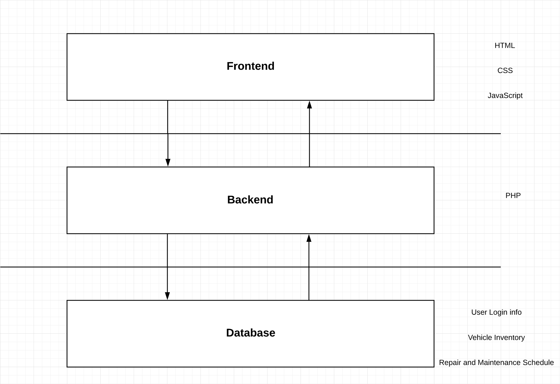
More features to add can be:
Server side: Php & Database (log-in, search, appraisal)
User Interface: JavaScript
Alternate: Node.js, React (framework like Bootstrap, Spring Boot and Flask)

Slide 6
FINAL version of mini-project1
link to our demo

Slide 7
Contribution
Topic selection: Yutong Gao
Page design: Yang Li
Programming:
Navigation bar: Yutong Gao
Animation: Yang Li, Yutong Gao
Search Bar: Yang Li
Social Media and news: Yutong Gao, Yang Li
Youtube and PPT: Yang Li, Yutong Gao
Notes:
Login features - Database for users

Slide 8
Thank You!
Notes:
Login features - Database for users

